Slide 1

ELL Leadership Academy
Karina E. Chapa, M.Ed.
Language Proficiency, Biliteracy and Cultural Diversity Director
kchapa@esc1.net
Twitter @esc1bilingual @bilingualpride

Slide 2

Professional Learning Essential Agreements
Be respectful of others
Be an active participant
Take care of your needs
Use electronic devices as learning tools
©2018 Region One Education Service Center

Slide 3
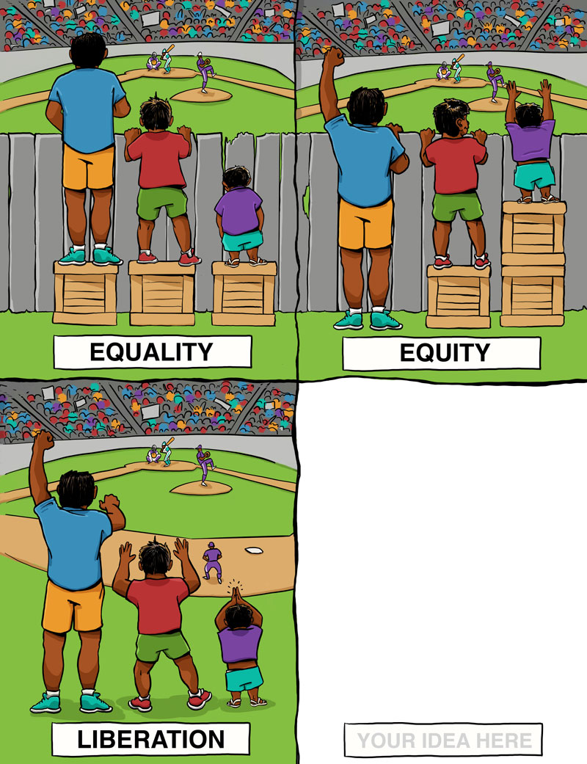
Think, Pair, Share!

Slide 4
Think, Pair, Share!

Slide 5
Think, Pair, Share!

Slide 6
Think, Pair, Share!
YOUR IDEA HERE

Slide 7
Sheltered instruction
Strategies

Slide 8
Session Objectives
Content Objective
Language Objective
Today I will explore sheltered instruction techniques and strategies to make content comprehensible for ELs.
Today I will share different ideas on how to implement sheltered instruction strategies in the classroom.

Slide 9
Three-Step Interview
Stand up when you can complete one of these sentences:
  Teaching ELLs is so difficult because…
  One challenge I face when teaching ELLs is…
  One challenge I face when instructing ELLs is… What I have done to overcome this challenge is…
Beginner
Intermediate
Advanced

Slide 10

What are the two goals of Sheltered Instruction?
Make Content Comprehensible
Develop Academic Language

Slide 11


Making Content Comprehensible

Slide 12
Making Content Comprehensible
Main Idea
#1
#2
#3
#4
Visual
Visual
Visual
Visual

Slide 13

SHELTERED INSTRUCTION
Content and Language Objectives

Slide 14

Make an Appointment

Slide 15
Content and language objectives

Slide 16

Anticipation Guide
kahoot.it
create.kahoot.it
Let’s Kahoot!

Slide 17
Round Table
Draw a T chart
Write everything you know about content and language objectives
15 seconds!
Pass your paper to your right!
Repeat!
Content Objectives
Language Objectives
Let’s Write!

Slide 18
The What and the How
Content Objectives come from the TEKS
What am I going to learn?
Language Objectives come from the ELPS
How will I demonstrate my learning through listening, speaking, reading and/or writing?
Content and Language Objectives

Slide 19
Content Objective - Sample
Science TEKS: Differentiate between structure and function in plant and animal cell organelles including cell membrane, cell wall, nucleus, cytoplasm, mitochondria, chloroplast and vacuole.
Student Friendly format: Today I will compare and contrast the cell structures and functions of plants and animals.

Slide 20
Writing Content Objectives
Pair-up
Analyze a Student Expectation (TEKS) from any content area
Write it in a student-friendly format on the top of your chart paper
You have 2 minutes
Today I will…

Slide 21
Science TEKS: Differentiate between structure and function in plant and animal cell organelles including cell membrane, cell wall, nucleus, cytoplasm, mitochondria, chloroplast and vacuole.
CONTENT OBJECTIVE
Today I will compare and contrast the cell structures and functions of plants and animals.
LANGUAGE OBJECTIVE
©2018 Region One Education Service Center

Slide 22
Language Objective - Sample
Content Objective:
Today I will compare and contrast the cell structures and functions of plants and animals.
Language Objective:
Today I will write an essay comparing and contrasting plant and animal cells utilizing transitional phrases.

Slide 23
Writing Language Objectives
Pair-up
Look back at the content objective you wrote
Write a language objective in a student-friendly format below your content objective
You have 2 minutes
Today I will…

Slide 24
Science TEKS: Differentiate between structure and function in plant and animal cell organelles including cell membrane, cell wall, nucleus, cytoplasm, mitochondria, chloroplast and vacuole.
CONTENT OBJECTIVE
Today I will compare and contrast the cell structures and functions of plants and animals.
LANGUAGE OBJECTIVE
Today I will write an essay comparing and contrasting plant and animal cells utilizing transitional phrases.
©2018 Region One Education Service Center

Slide 25
Key Points to Remember
Make objectives student friendly and appropriate for grade level.
Objectives are for students, not for the adults in the classroom.
Post eye level.
Review with students before, during and after each lesson.

Slide 26
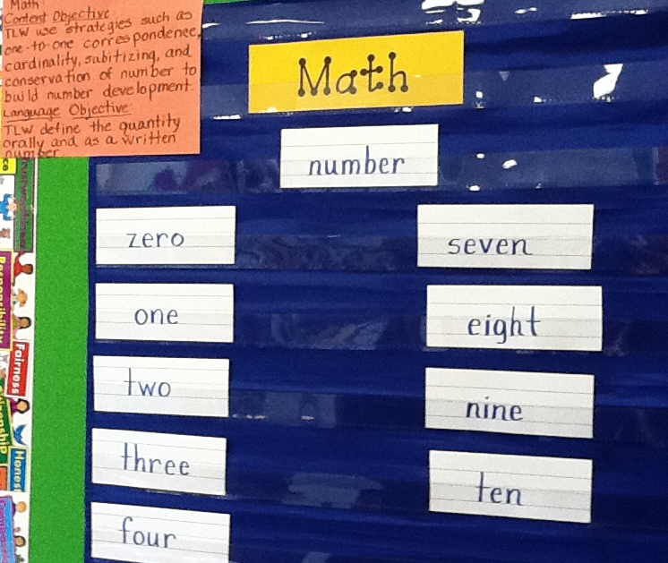
Provide Feedback
Content and Language Objectives

Slide 27
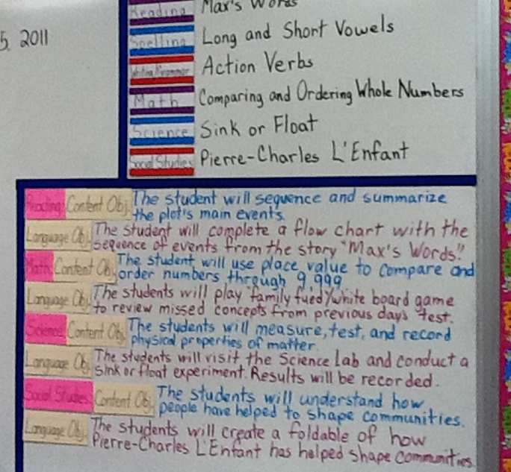
Provide Feedback
Content and Language Objectives

Slide 28
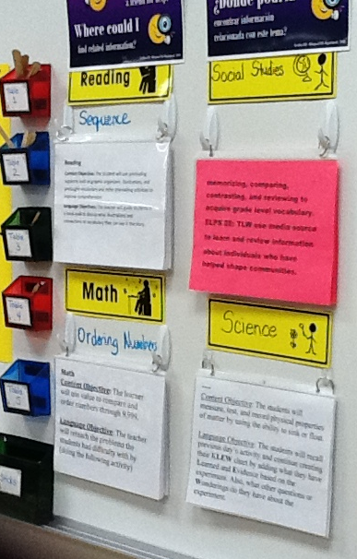
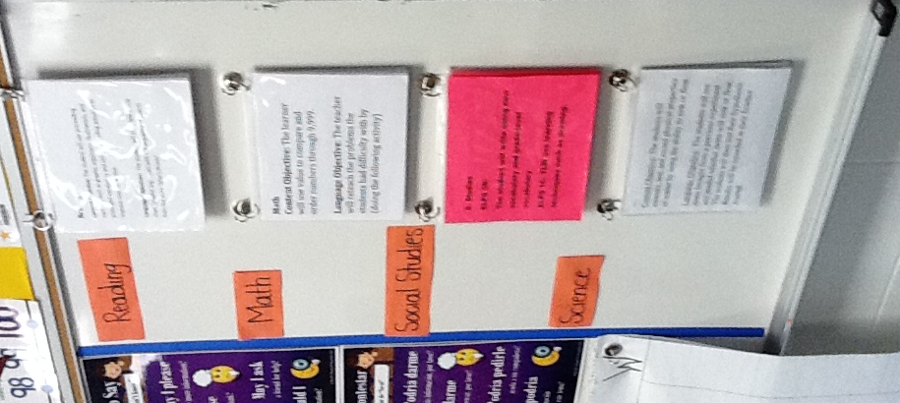
Provide Feedback

Slide 29
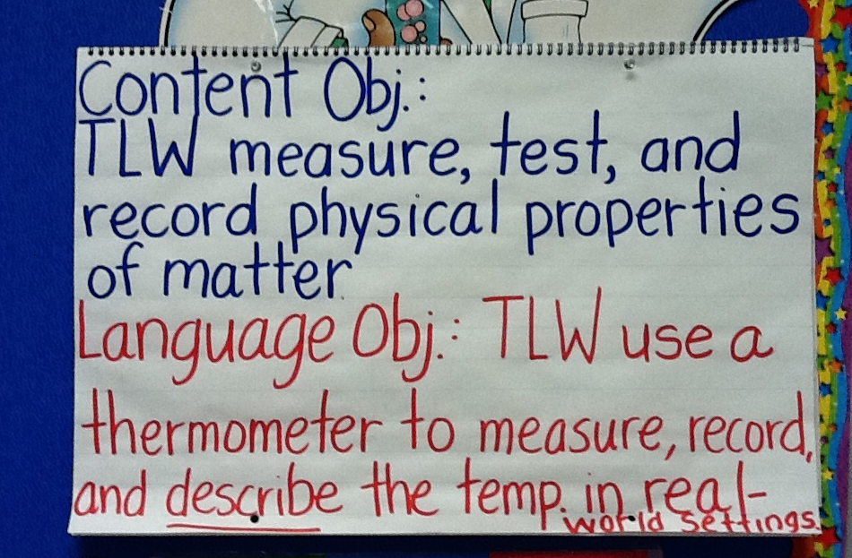
Provide Feedback

Slide 30
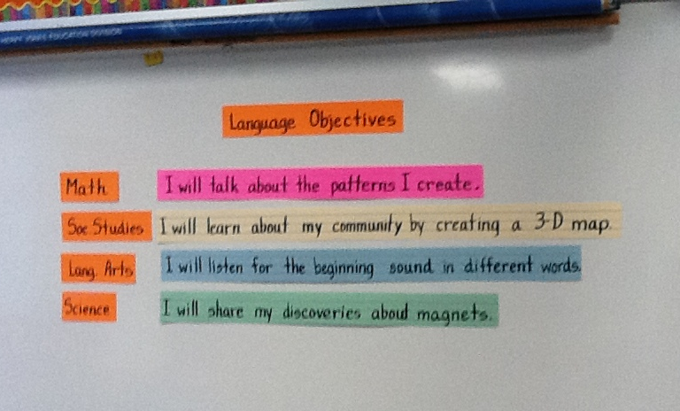
Provide Feedback

Slide 31
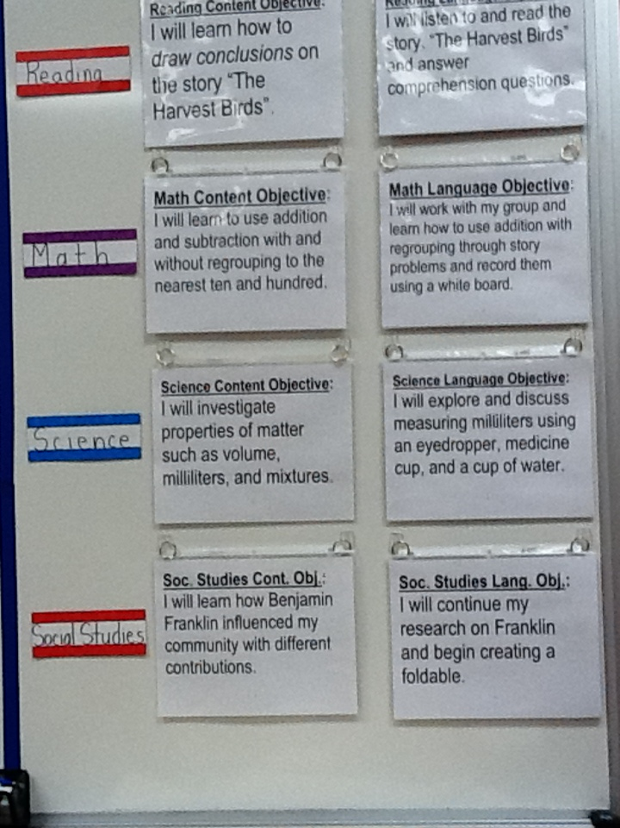
Provide Feedback
Content and Language Objectives

Slide 32
SHELTERED INSTRUCTION
Content and Language Objectives

Slide 33
Structured reading activities

Slide 34
SHELTERED INSTRUCTION
Content and Language Objectives
Structured Reading Activities

Slide 35
Structured Reading and Writing Activities
Adapted Texts
SQP2RS
Graphic Organizers
Thinking Maps
Jigsaw Reading
Outlines
Highlighted Texts
1-2-4-All
Round Table
Taped Texts
Marginal Notes
Native Language Texts
Write-Read-Read-Trade
Read-Cover-Remember-Retell-Sketch!

Slide 36
SQP2RS
Survey
Question
Predict
Read
Response
Summarize

Slide 37
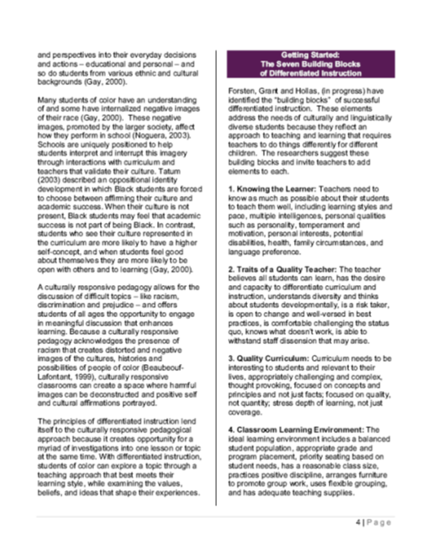
SQP2RS
Survey
Question
Predict
Read
Response
Summarize

Slide 38



Inside-Outside Circle
A
Read
Cover
Remember
Retell
Sketch!
B
AB

Slide 39
Go to your 6 o’clock
One of the benefits of including structured reading and writing activities in my classroom is…
One of the challenges of including structured reading and writing activities in my class is…
Something I can do to overcome this challenge is…

Slide 40
SHELTERED INSTRUCTION
Content and Language Objective
Structured Reading Activities

Slide 41
Structured conversations

Slide 42
SHELTERED INSTRUCTION
Content and Language Objective
Structured Reading Activities
Structured Conversations

Slide 43
1-2-4-ALL
Why is it important to encourage English Learners to speak in complete sentences?
Write your individual answer on a piece of paper.
Share with a partner and add any new ideas to your paper.
Now share your answers with another pair and keep adding new ideas to your own papers.
As a whole table come up with a final complete answer.

Slide 44
Use of Complete Sentences
Does this mean that students need to answer in complete sentences all the time?
TIP:
Provide students with sentence frames and sentence starters if they are struggling to produce complete thoughts in English.

Slide 45
Use of Complete Sentences
  1. When reviewing a handout or worksheet
    Non-Example
    Teacher: How much is 5 X 4?
    Student: 20!
    Example
    Teacher: What is the product of 5 X 4?
    Student: The product of 5 and 4 is 20

Slide 46
Use of Complete Sentences
  2. When students are given sentence starters
    Non-Example
    Teacher: Who is your favorite character and why?
    Student: Esperanza!
    Example
    Teacher: Who is your favorite character and why? Please complete the following sentence: “My favorite character is… because…”
    Student: My favorite character is Esperanza, because she was very brave.

Slide 47
Your Turn! Gallery Walk!
Using the Content and Language Objectives that you developed, write 1 question and 1 sentence stem that your students might be able to answer throughout the lesson.
Write them on post-its and place them on your chart paper.

Slide 48

Structured Conversations
Think-Pair-Share
Think-Write-Pair-Share
Question-Signal-Stem-Share-Assess
Expert Gallery Walk
Three-Step Interview
1-2-4-All

Slide 49
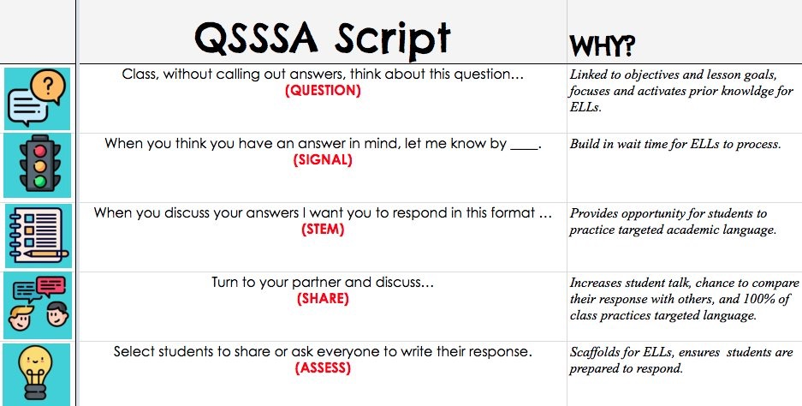
Why do ELs need to have structured conversations?
Standing up!
English Learners need structured conversations because…
(talk, talk, talk!)
Student #18, please share your response with the whole group
@MrsGill_ @MsSalvac @Seidlitz_Ed @JohnSeidlitz

Slide 50
SHELTERED INSTRUCTION
Content and Language Objectives
Structured Reading Activities
Structured Conversations

Slide 51
Developing academic vocabulary

Slide 52
SHELTERED INSTRUCTION
Content and Language Objectives
Structured Reading Activities
Structured Conversations
Developing Academic Vocabulary

Slide 53
1. When you can complete this sentence in your mind, please stand up.
Academic vocabulary development is important for ALL students, but especially for ELs, because…
2. Find your 9 o’clock appointment and share your responses.

Slide 54
What does this mean?
Carving is appropriate for most green and blue slopes and even some black slopes. However, if you try to carve through moguls, especially in packed powder or corn snow, you’re going to face-plant.

Slide 55
What does this mean?
Carving is appropriate for most green and blue slopes and even some black slopes. However, if you try to carve through moguls, especially in packed powder or corn snow, you’re going to face-plant.

Slide 56
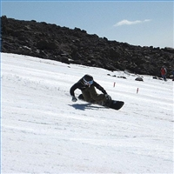

Would this help?
These men are carving.

Slide 57
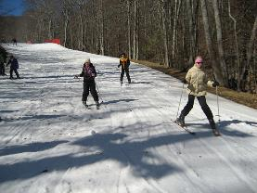
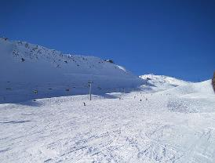
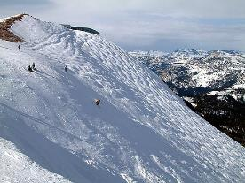
How about this?
Green Slope
Blue Slope
Black Slope

Slide 58
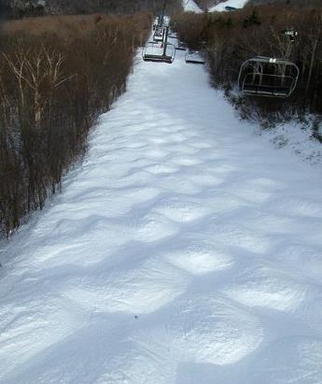
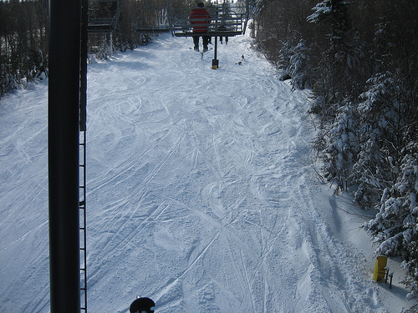
Moguls Packed Powder

Slide 59
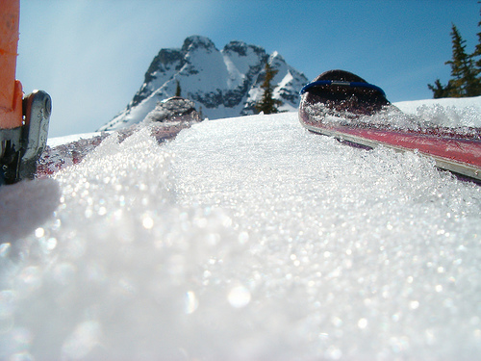
Corn Snow

Slide 60
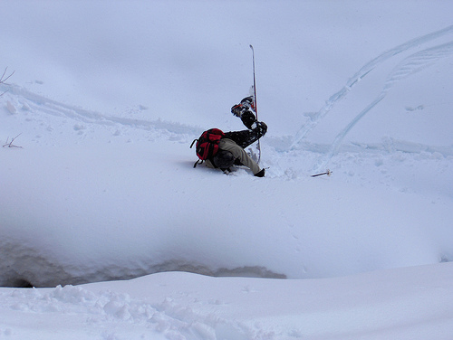
Face-plant

Slide 61









Carving is appropriate for most green and blue slopes
and even some black slopes. However, if you try to carve
through moguls, especially in packed powder or corn snow
you’re going to face-plant.
apropiado
especialmente

Slide 62
Vocabulary Experts
Number Heads 1-8
Form Expert Groups
Each team creates a visual explaining the activity
Back to original groups
Expert Groups

Slide 63




1. Free Association
http://bit.do/freeassociation
2. Comparing Terms
http://bit.do/comparingterms
3. Classifying Terms
4. Solving Analogy Problems
5. Creating Metaphors
6. Vocabulary Charades
7. Talk a Mile a Minute
http://bit.do/morevocabulary
8. Pyramid Game
http://bit.do/ pyramidgame
Notes:
3.5 hours

Slide 64
SHELTERED INSTRUCTION
Content and Language Objective
Structured Reading Activities
Structured Conversations
Developing Academic Vocabulary

Slide 65
Session Objectives
Content Objective
Language Objective
Today I explored sheltered instruction techniques and strategies to make content comprehensible for my ELLs.
Today I shared different ideas on how to implement sheltered instruction strategies in my classroom.

Slide 66
¡Mil gracias!
See you on 01/12/19
Karina E. Chapa, M.Ed.
Language Proficiency, Biliteracy and Cultural Diversity Director
kchapa@esc1.net
Facebook: Region One ESC Bilingual
Twitter @esc1bilingual @bilingualpride

